Slide 1
Biometric Cryptosystems: A new Biometric Key Binding for Fingerprint Minutiae-Based Representation.
Shivam Verma (2020CS50442)
SIL775 Reading Assignment

Slide 2
Biometric Cryptosystems
It combines biometrics with cryptography to securely generate, store or release cryptographic keys using biometric data of an individual.
Main approaches:
Key Generation
- Directly generating a key from biometric data.
- Less popular, due to large intra-user variability of biometrics (could give different keys due to variations).
2. Key Binding
- Binding a pre-existing cryptographic key (externally generated and independent) to biometric data.
- Key is released only if the query instance is similar to the template.
- ECC is used to manage variations of biometric data.

Slide 3
How Key Binding works?
Step 1: Enrollment
A cryptographic key is provided as input.
The user’s biometric data (e.g., fingerprint) is captured and processed into a biometric template.
The key and biometric template are combined (e.g., Fuzzy Commitment algorithm).
The result is stored as secure template in the system.
Step 2: Authentication
The user presents his biometric data again (e.g., scans his fingerprint).
The system processes the new biometric sample and compares it to stored secure template.
If it matches within an acceptable error tolerance, the original key is released.

Slide 4
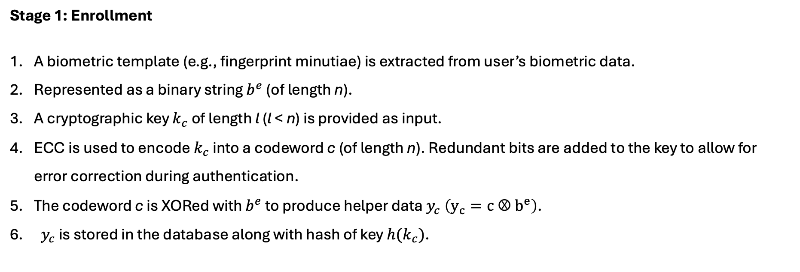
Fuzzy Commitment (1)
Protects cryptographic keys using biometric data while allowing some tolerance in biometric matching.
Stage 1: Enrollment
A biometric template (e.g., fingerprint minutiae) is extracted from user’s biometric data.
Represented as a binary string $b^{e}$ (of length n).
A cryptographic key $k_{c}$ of length l (l < n) is provided as input.
ECC is used to encode $k_{c}$ into a codeword c (of length n). Redundant bits are added to the key to allow for error correction during authentication.
The codeword c is XORed with $b^{e}$ to produce helper data $y_{c} \left(y_{c}=c Ⓧ{ b}^{e}\right)$.
${ y}_{c}$ is stored in the database along with hash of key $h(k_{c})$.

Slide 5
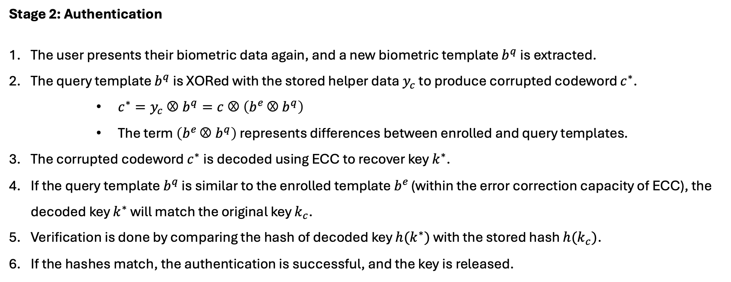
Fuzzy Commitment (2)
Stage 2: Authentication
The user presents their biometric data again, and a new biometric template $b^{q}$ is extracted.
The query template $b^{q}$ is XORed with the stored helper data $y_{c}$ to produce corrupted codeword $c^{∗}$.
$c^{∗}=y_{c} Ⓧ b^{q}=c Ⓧ \left(b^{e }Ⓧ b^{q}\right)$
The term $\left(b^{e }Ⓧ b^{q}\right)$ represents differences between enrolled and query templates.
The corrupted codeword $c^{∗}$is decoded using ECC to recover key $k^{∗}$.
If the query template $b^{q}$ is similar to the enrolled template $b^{e }$(within the error correction capacity of ECC), the decoded key $k^{∗}$ will match the original key $k_{c}$.
Verification is done by comparing the hash of decoded key $h(k^{∗})$ with the stored hash $h(k_{c})$.
If the hashes match, the authentication is successful, and the key is released.

Slide 6
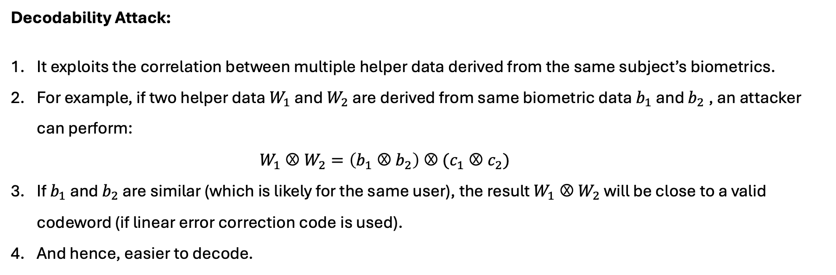
Fuzzy Commitment (3)
Despite its theoretical soundness, there are some attacks proposed against FC.
Decodability Attack:
It exploits the correlation between multiple helper data derived from the same subject’s biometrics.
For example, if two helper data $W_{1}$ and $W_{2}$ are derived from same biometric data $b_{1}$ and $b_{2}$, an attacker can perform:
$$W_{1} Ⓧ W_{2}=\left(b_{1} Ⓧ b_{2}\right) Ⓧ (c_{1} Ⓧ c_{2})$$
If $b_{1}$ and $b_{2}$ are similar (which is likely for the same user), the result $W_{1} Ⓧ W_{2}$ will be close to a valid codeword (if linear error correction code is used).
And hence, easier to decode.

Slide 7
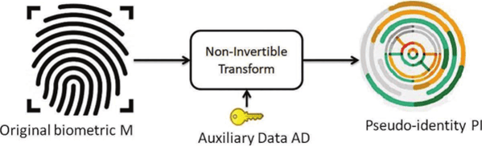
Cancellable Biometrics
It protects biometric templates by applying an irreversible transform to the biometric data before storing it.
Why its important?
- If a biometric template is stolen, it cannot be replaced (like a password or PIN). Hence template protection is crucial.
- Cancellable biometrics ensure that even if a transformed template is compromised, the original biometric data cannot be recovered, and a new template can be issued.

Slide 8
Minutiae Based Fingerprint Templates (1)
Minutiae: Most widely used features for fingerprint recognition (represent points like ridge ending and bifurcation).
Minutiae based templates are unordered and variable in size.
Divided into 2 categories:
Fixed-Length Representation.
Binary representation based on histograms of triangular features generated from minutiae triplets.
Seven invariant features (lengths of sides, angles, and height of the triangle) are extracted and converted into a 24-bit binary string.
Cancellability is achieved by permuting the binary string using an external seed.
Limitation: High computational cost due to the exhaustive calculation of features for all possible minutiae triplets.

Slide 9
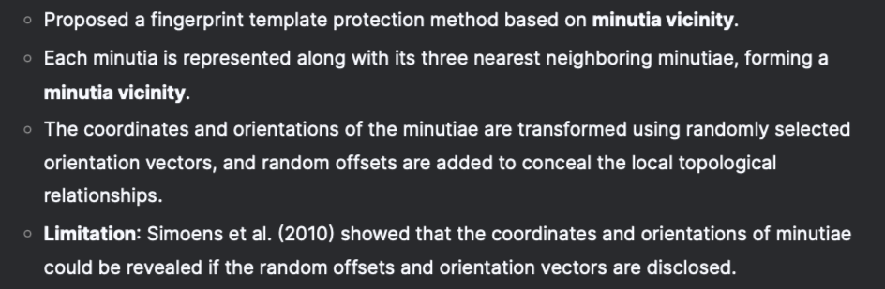
Minutiae Based Fingerprint Templates (2)
2. Variable-Length Representation.
The fingerprint template is represented as a variable-length matrix (e.g., m*n, where m is the number of minutiae and n is the length of the feature vector derived from a single minutia).
Yang and Busch (2009):

Slide 10
New Biometric Key-Binding Scheme
Fuzzy Commitment and Cancellable Biometrics have limitations:
Security - Performance Tradeoff (large key size -> lower key release rate).
Vulnerability to Attacks
Authors combine the strengths of both paradigms while overcoming their weaknesses.
Proposed an ECC-free key binding scheme along with cancellable transforms (for minutiae-based biometrics).
Inspired from chaffing and winnowing scheme.

Slide 11
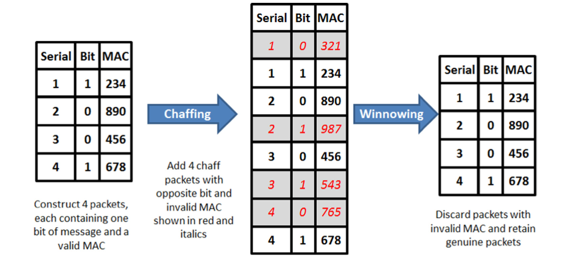
Chaffing and Winnowing Scheme
Achieve confidentiality without encryption when sending data over insecure channel.
Steps involved:
The sender adds fake packets with bogus message authentication code (MACs) [chaffing]
The receiver discards the packets with bogus MACs [winnowing]
The eavesdropper can’t distinguish between fake and real packets (it doesn’t have secret key information)

Slide 12
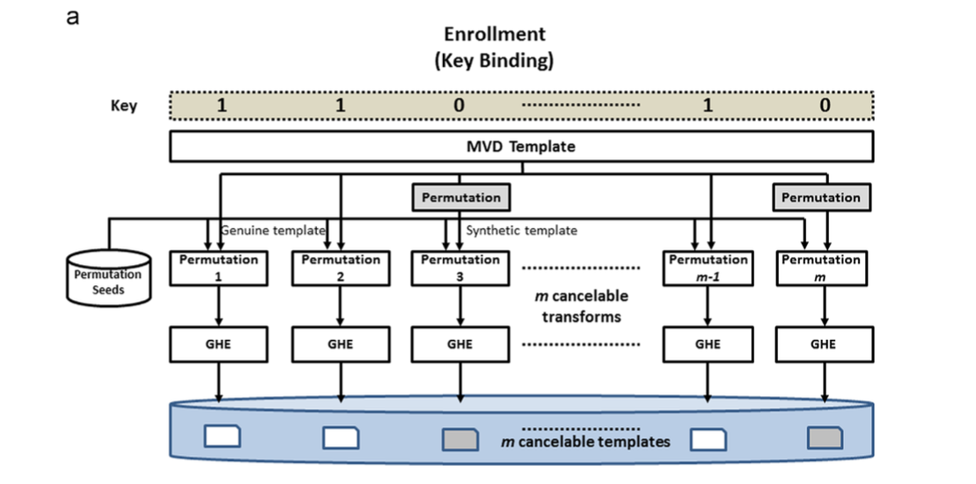
Proposed Scheme (Key Binding)
Given binary key ‘k’ as input.
Encode ‘1’s in k with true template of user.
Encode ‘0’s in k with synthetic template.
Encoding Process:
Apply cancellable transforms to templates (either true or synthetic) and use different transformation seed.
Cancellable Transform:
Consists of one permutation process along with GHE (graph-based hamming embedding transform)
** MVD: Minutia Vicinity Decomposition (a minutiae representation technique)

Slide 13
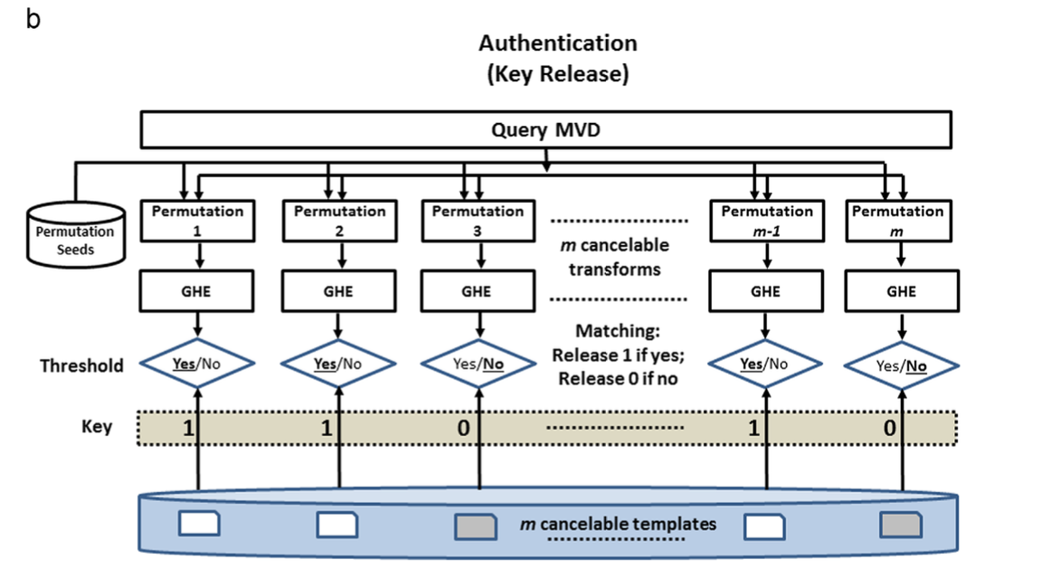
Proposed Scheme (Key Release)
Apply m (size of the key) cancellable transforms to the query data to yield m cancellable query instances.
Match these cancellable query instance with the stored cancellable templates and compare the matching score.
If the matching score > threshold, release 1, otherwise 0.

Slide 14
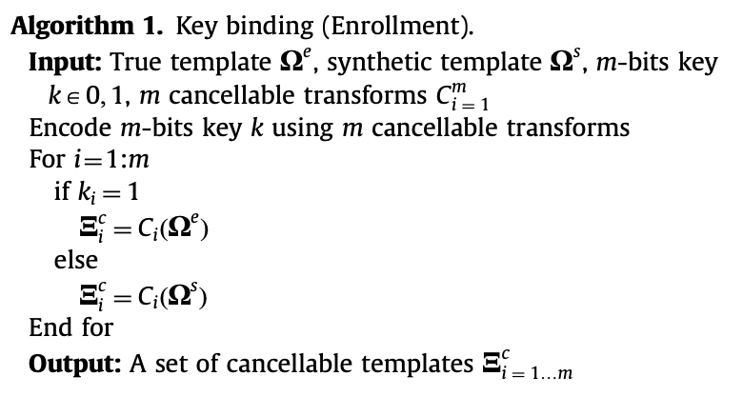
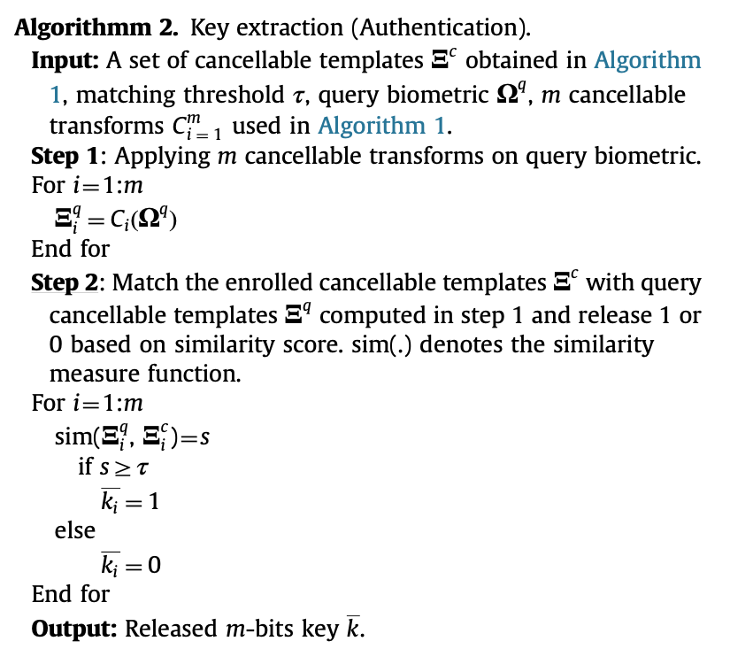
Algorithm

Slide 15
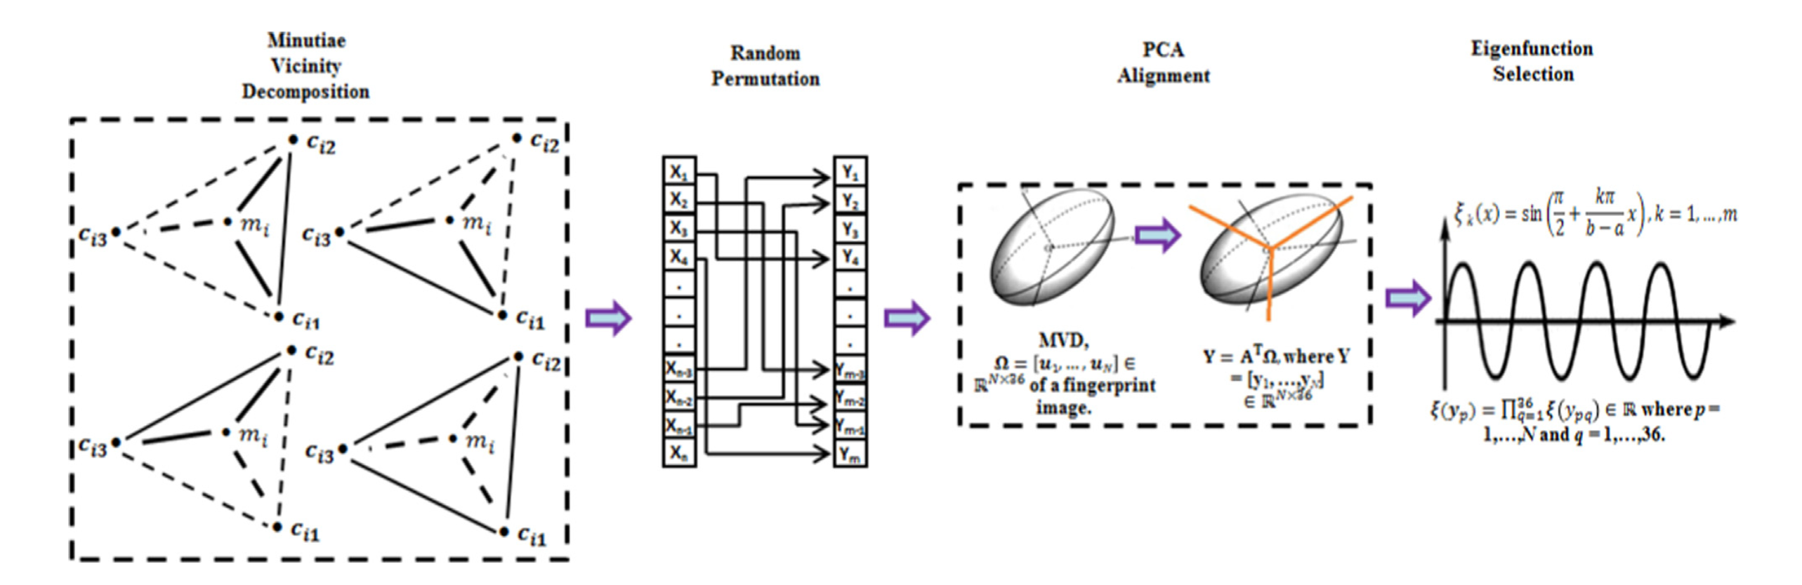
Synthetic Templates
Some of the options presented in the paper to generate synthetic templates:
Different biometric modalities (fingerprint for true template, palmprint for synthetic)
Use imposter templates as synthetic ones.
Cancellable transform used in the paper:

Slide 16
Conclusion
Proposed an ECC-free key binding scheme along with cancellable transforms.
The security-performance tradeoff is resolved in this scheme (stable accuracy despite increasing the key size).
Thank You.

